Slide 1

CONSUMER GOODS COUNCIL
CRIME RISK SEMINAR
14 MAY 2025
SOUTH AFRICAN POLICE SERVICE
GAUTENG PROVINCE

Slide 2
PRESENTATION OVERVIEW
Purpose of the presentation
Introduction
Crime Threat Analysis
Crime Overview
Mitigating Measures
Conclusion

Slide 3

PURPOSE

Slide 4
PURPOSE
Purpose of the Presentation is to brief the attendees at the CGCSA Crime Risk Seminar, on matters related to crime threats against the Retail Industry as well as to highlight mitigating measures implemented to address such threats

Slide 5
INTRODUCTION

Slide 6
INTRODUCTION
  The retail industry faces significant challenges from various types of crimes, including theft, robbery, and cybercrime, which can have a substantial impact on businesses and the economy.
  Crimes in the retail industry can result in financial losses, damage to property, and harm to employees and customers, ultimately affecting the overall profitability and sustainability of businesses.
  Addressing crimes in the retail industry requires a collaborative effort between retailers, law enforcement agencies, and other stakeholders to share intelligence, best practices, and resources.
  The retail industry is constantly evolving, and crime trends are shifting, with the rise of e-commerce and digital payments creating new opportunities for cybercrime and online fraud.
  Prevention is key to addressing crimes in the retail industry, and a proactive approach can help to reduce the risk of crimes occurring and minimize their impact.

Slide 7
CRIME THREAT ANALYIS

Slide 8
CRIME THREAT ANALYSIS
The retail industry is one of the sectors most affected by business robberies, which have a significant negative impact on the South African economy. These crimes are estimated to cost at least 10% of the country’s Gross Domestic Product (GDP) annually, contributing to financial losses, increased security expenditures, and missed economic opportunities.
Direct Costs:
Loss of goods and cash: Businesses suffer direct financial losses when criminals steal assets and revenue.
Security and insurance expenses: Companies are forced to invest heavily in security upgrades, higher insurance premiums, and, in some cases, private security services to mitigate future risks.
Property damage: Robberies often result in physical damage to business premises, leading to costly repairs and, in severe cases, temporary closures that disrupt operations.

Slide 9
CRIME THREAT ANALYSIS
  The most common MODUS OPERANDI used by criminals involves two or more perpetrators entering a business premises, where they threaten and intimidate victims at gunpoint or with knives to seize goods and large sums of cash.
  Typically, suspects approach a targeted store or business under the guise of being customers. Once inside, they swiftly draw firearms, often aiming them at cashiers or managers to forcefully demand cash and valuables. In some cases, the cashier is coerced at gunpoint to open the safe, increasing the scale of the theft.
  During these crimes, murder and attempted murder frequently occur, with victims being shot in the course of the criminal act.
  Firearms such as handguns, pistols, and revolvers play a significant role in the execution of these robberies, contributing to the severity of the attacks.

Slide 10
CRIME THREAT ANALYSIS
  To evade detection, suspects commonly utilize vehicles fitted with false registration plates, making them difficult to trace after committing the crime.
  These criminal groups typically operate in teams of three or more individuals, often including female accomplices as well.
  Stolen items, such as cell phones, laptops, cash, and other valuables are quickly packed into large bags before the perpetrators flee with their loot.
  Certain criminal networks have been found to involve foreign nationals, some of whom play a significant role in facilitating the trade of stolen goods. In addition to receiving and distributing illegally obtained items, they may also coordinate the smuggling of stolen merchandise across borders, further complicating efforts to curb organized crime.

Slide 11
CRIME THREAT ANALYSIS
The following retail stores are mostly targeted during these robberies:
  CHAIN STORES (stealing/robbing cash and cellphones)
  MALLS / SHOPPING CENTRES
  FILLING STATIONS (Cash, Fuel, cigarettes, airtime, including ATM bombings)
  WAREHOUSES / STORAGE FACILITIES
  JEWELLERY STORES

Slide 12
Crime overview

Slide 13
Crime overview
  The following slides present an analysis of crime statistics from October 2020 to December 2024, highlighting significant changes and trends over the years. The last quarter (Oct-Dec 2024) showed promising decreases in several categories.
  Key Crime Categories:
  Robbery at Non-Residential Premises:
    21.3% decrease in incidents.
  Robbery of Cash in Transit:
    17 fewer counts observed.
  Truck Hijacking:
    14% decrease in incidents, reflecting improved security measures.
  Burglary at Non-Residential Premises:
    19% reduction, indicating better preventive strategies.
  All Theft Not Mentioned Elsewhere:
    7.6% decrease, though still a concern due to high volumes.
  Commercial Crime:
    8.9% increase, necessitating focused interventions.

Slide 14
Crime overview
 | CRIME CATEGORY | October 2020 to December 2020 | October 2021 to December 2021 | October 2022 to December 2022 | October 2023 to December 2023 | October 2024 to December 2024 | Count Diff | (%) Change
 | Robbery at non-residential premises | 5 052 | 5 138 | 4 983 | 4 825 | 3 796 | -1 029 | -21,3%
 | Robbery of cash in transit | 65 | 60 | 57 | 46 | 29 | -17 | 17 counts lower
 | Truck hijacking | 436 | 448 | 492 | 480 | 413 | -67 | -14,0%
 | Burglary at non-residential premises | 15 550 | 14 408 | 16 286 | 15 326 | 12 412 | -2 914 | -19,0%
 | All theft not mentioned elsewhere | 62 195 | 64 214 | 71 147 | 68 691 | 63 449 | -5 242 | -7,6%
 | Commercial crime | 23 428 | 27 155 | 28 545 | 33 475 | 36 446 | 2 971 | 8,9%

Slide 15
Robbery at non-residential premises
District Picture

Slide 16
Robbery at non-residential premises: top instrument's used: Oct 2024 to Dec 2024

Slide 17
Robbery at non-residential premises: top METHODS used Oct 2024 to Dec 2024

Slide 18
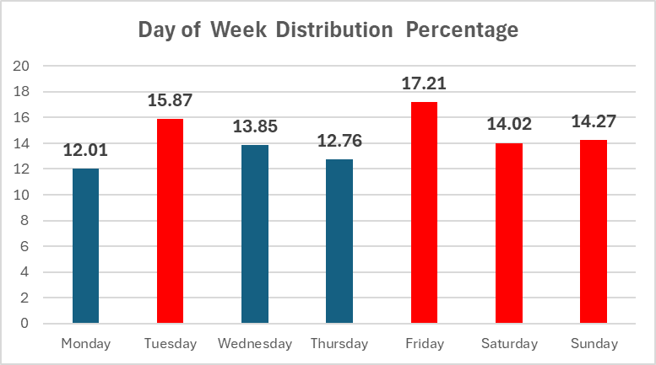
Robbery at non-residential premises:
DAY OF WEEK :Oct 2024 to Dec 2024

Slide 19
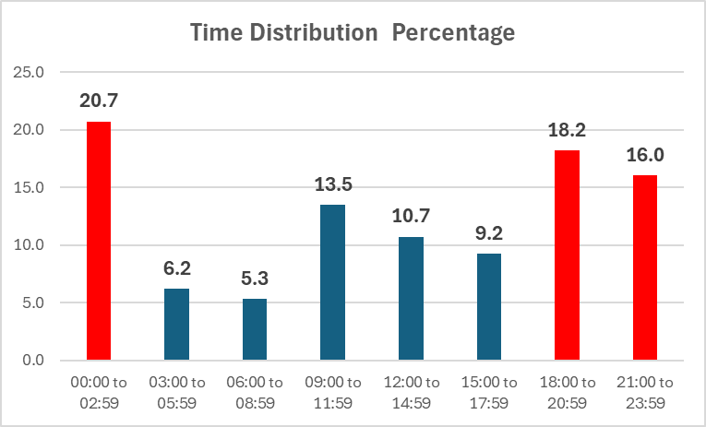
Robbery at non-residential premises: time Oct 2024 to Dec 2024

Slide 20
Burglary at non-residential premises
District Picture

Slide 21
Burglary at non-residential premises: top instrument's used : Oct 2024 to Dec 2024

Slide 22
Burglary at non-residential premises: top METHODS used : Oct 2024 to Dec 2024

Slide 23
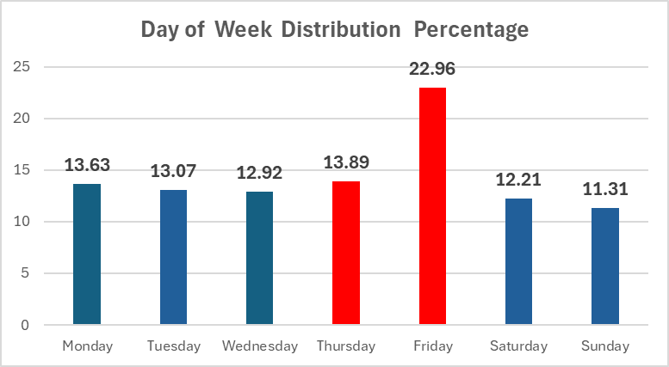
Burglary at non-residential premises:
DAY OF WEEK : Oct 2024 to Dec 2024

Slide 24
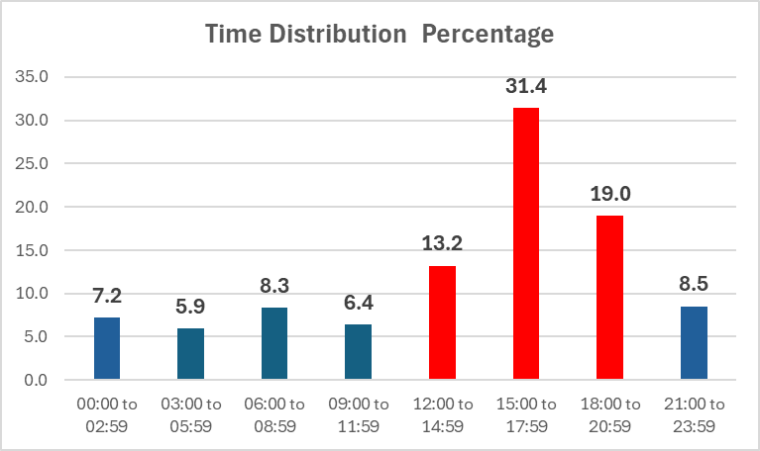
Burglary at non-residential premises: time :Oct 2024 to Dec 2024

Slide 25
Robbery of cash in transit
District Picture

Slide 26
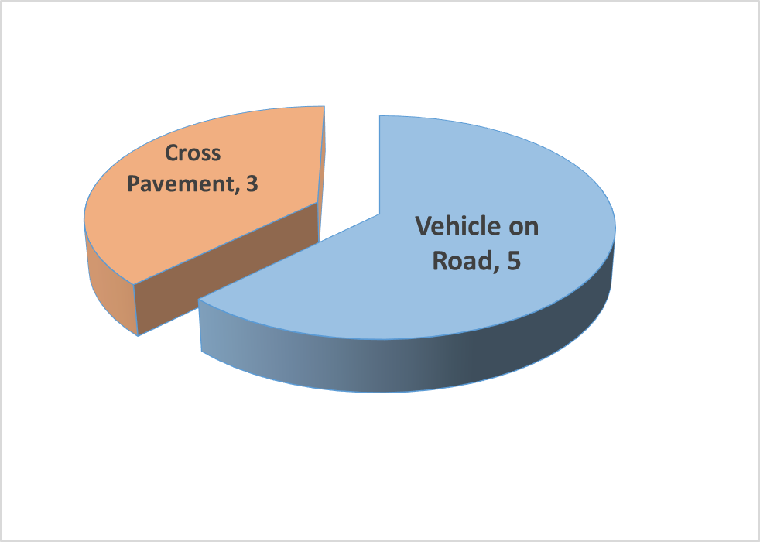
Robbery of cash in transit (CIT)
3rd Quarter 2024/2025
Type of cash in transit robbery – (method used)
District contributed: XP
Ekurhuleni=1
Tshwane = 1
Sedibeng =1
Type of companies affected:
FCS =6
G4S =2
District contributed: VOR
Ekurhuleni = 2
Johannesburg = 3
Perpetrators threatened security guards by pointing them with firearms in all 8 incidents.
Explosives were used in 5 incidents
Vehicles were rammed in 4 incidents
In 7 incidents the suspects shot at the CIT vehicle / personnel.
TOTAL CIT COUNTS = 8

Slide 27
Cash-in-transit (CIT) robberies: top instrument's used :Oct 2024 to Dec 2024

Slide 28
Cash-in-transit (CIT) robberies: top METHODS used : Oct 2024 to Dec 2024

Slide 29
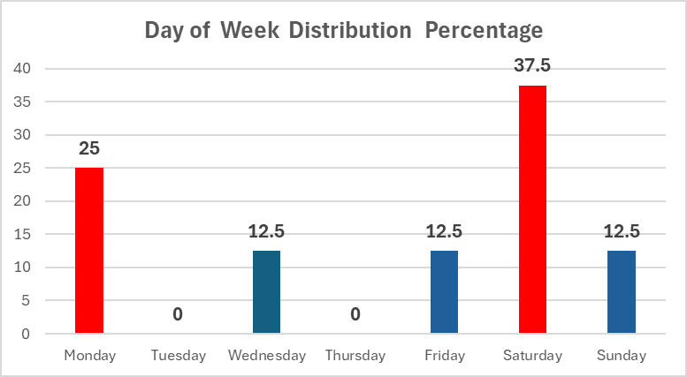
Cash-in-transit (CIT) robberies:
DAY OF WEEK :Oct 2024 to Dec 2024

Slide 30
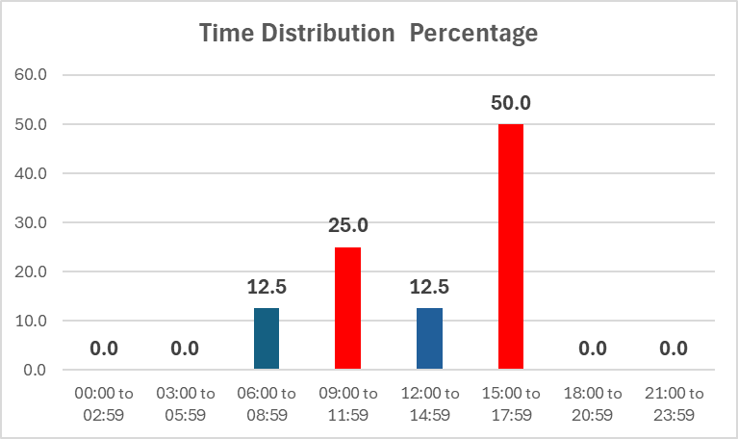
Cash-in-transit (CIT) robberies: time distribution : Oct 2024 to Dec 2024

Slide 31
Commercial crime
District Picture

Slide 32
Commercial crime: top instrument's used :Oct 2024 to Dec 2024

Slide 33
Commercial crime: top METHODS used : Oct 2024 to Dec 2024

Slide 34
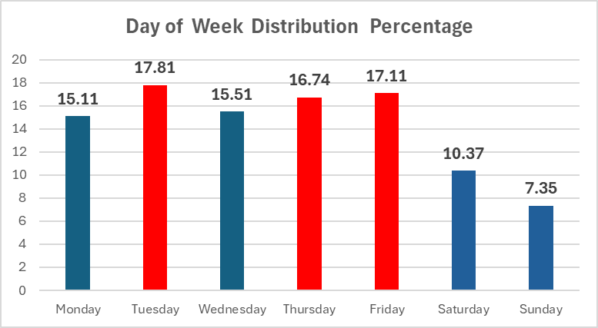
Commercial crime:
DAY OF WEEK : Oct 2024 to Dec 2024

Slide 35
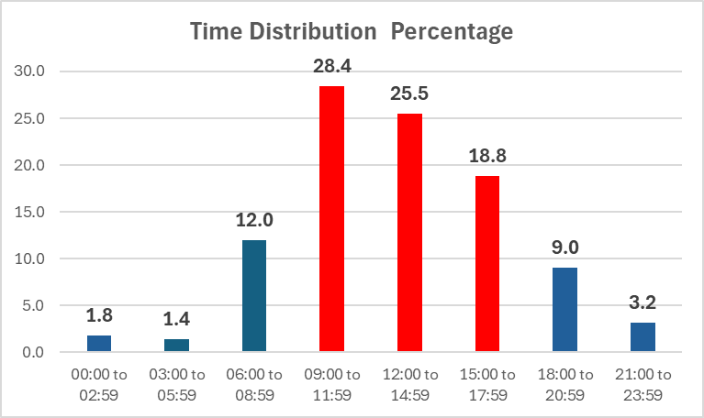
Commercial crime: time distribution :Oct 2024 to Dec 2024

Slide 36
Truck hijacking
District Picture

Slide 37
Truck Hijacking: top instrument's used :Oct 2024 to Dec 2024

Slide 38
Truck Hijacking: top METHODS used :Oct 2024 to Dec 2024

Slide 39
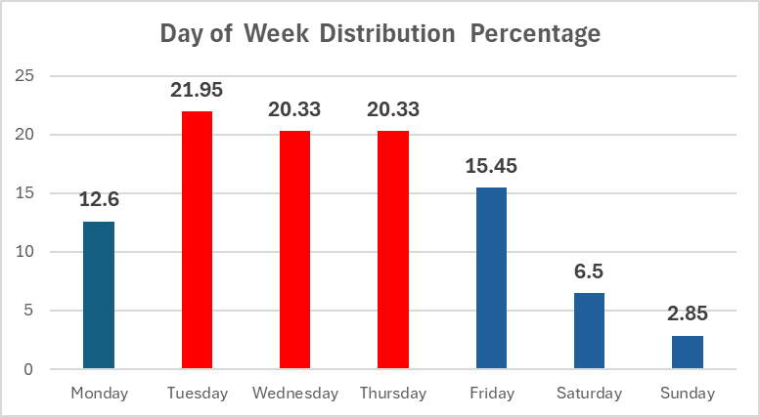
Truck Hijacking:
DAY OF WEEK :Oct 2024 to Dec 2024

Slide 40
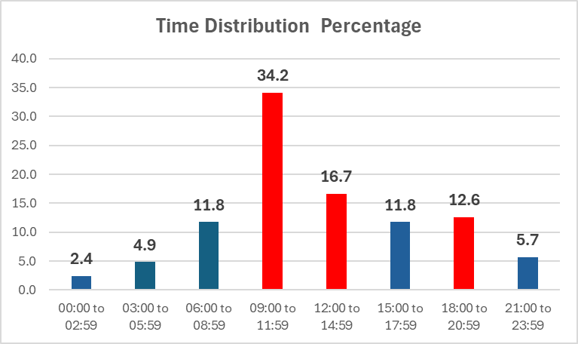
Truck Hijacking: time distribution
Oct 2024 to Dec 2024

Slide 41
All theft not mentioned elsewhere
District Picture

Slide 42
Theft General: top instrument's used :Oct 2024 to Dec 2024

Slide 43
Theft General: top METHODS used :Oct 2024 to Dec 2024

Slide 44
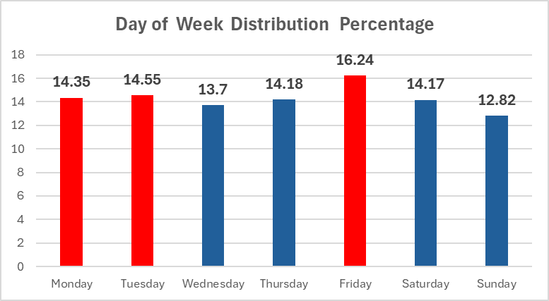
Theft General:
DAY OF WEEK :Oct 2024 to Dec 2024

Slide 45
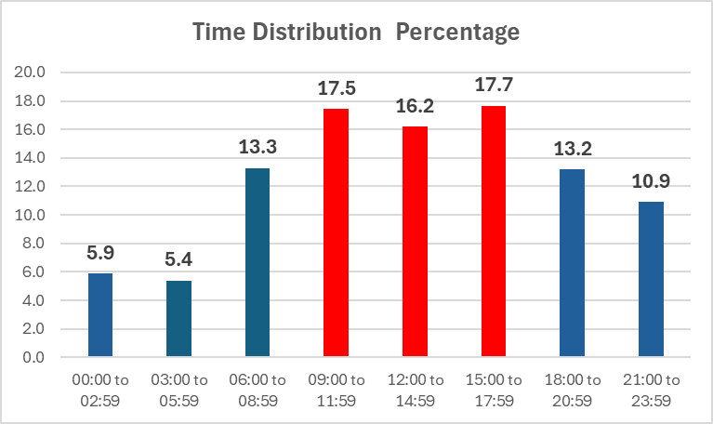
Theft General: time distribution :Oct 2024 to Dec 2024

Slide 46
MITIGATING MEASURES

Slide 47
MITIGATING MEASURES : PROACTIVE
  Various mitigating measures from a proactive point of view is implemented to address crime threats against the Retail Industry of which a few are highlighted below:
    Operation Shanela provides a multi – disciplinary approach in stamping the Authority of the State in Gauteng with Provincial operations being conducted every Thursday and Saturday throughout the Province.
    The Gauteng Provincial Operational Command Centre (POCC) is fully implemented and functional to offer rapid intelligence-led actions.
    High police visibility in identified hotspot areas and joint deployment by all law enforcement agencies through the newly established Cooperation Agreements between the SAPS and the three cities, Johannesburg, Tshwane and Ekurhuleni in Gauteng.
    Fully functional Priority Committees with in the Gauteng PROVJOINTS.
    Crimes generated by Illicit Mining and Robbery Aggravated all receive priority interventions to address these crimes, including operations on Gauteng Fuel Pipelines.
    The Gauteng E2 project is implemented and offers an integrated response to all crime by Law Enforcement Agencies and the Private Security Industry.

Slide 48
MITIGATING MEASURES : PROACTIVE (2)
  The Gauteng PROVJOINTS meeting is conducted on a monthly basis and provide strategic direction relating to the established priority committee focussing inter alia on the following:
  Transport
  Essential Infrastructure
  Rural Safety
  Education
  Cash In Transit
  Fuel Pipeline
  Illegal Gambling
  Illegal Land Invasions
  Illegal Mining at other mines

Slide 49
MITIGATING MEASURES : PROACTIVE (3)
The Gauteng Second Hand Goods Forum is responsible for coordinating the following crime prevention activities within the Province:
- Enforcing the Second-Hands Goods Act 6 of 2009 to regulate dealing in second-hand goods and pawnbrokers, in order to combat the trade in stolen goods and to promote ethical standards in the second-hand goods trade.
- Ensure Scrap metal dealers, general dealers, recyclers and communication dealers are policed.
The Gauteng Counterfeit and Illicit Goods Policing Unit was established to deal with the prevention and combatting of counterfeit goods that is causing serious damage to brand owners and the economy of South Africa.
Implementation and deployment of Essential Infrastructure Task Teams (EITT) in all five districts of Gauteng to enforce the Criminal Matters Amendment (CMA) Act, 2015 (Act No 18 of 2015) and prevent the destruction of essential infrastructure.

Slide 50
MITIGATING MEASURES : reactive
  From a reactive point of view the following mitigating measures are in place as part of the investigative process:
    Thorough interview of Complainants,
    Visiting and processing of Crime Scenes,
    Identification of specific crime threats,
    Tasking of crime intelligence to gather intelligence on specific crime threats,
    Identification and profiling of targets,
    Application in terms of Section 205 for cell phones taken,
    Linking of the identified targets on specific cases.

Slide 51
MITIGATING MEASURES : reactive (2)
    All evidence needs to be collected to ensure a strong case (video footages, expert statements),
    Involvement of Internal and external role players i.e. (SABRIC or Consumer Commissioner),
    Screening of Employees employed by the retail industry,
    Creating a data base from detailed incident reports of all incidents of Theft, Fraud and vandalism as
    Conduct detail audits of stolen items and circulate property with serial numbers.
    Upgrading of surveillance and security measures are vital.
    Provide new and modern techniques to deal with crime threats.
    Tasking of informers, trace and arrest the suspects involved.

Slide 52
CONCLUSION

Slide 53
conclusion
The South African Police Service remains resolute to fulfil its Constitutional mandate in terms of Section 205 (3) of the Constitution and continue to implement all efforts to ensure all people are and feel safe.

Slide 54
THANK YOU

